Slide 1

^{27th} March 2026
M2 – AUTOMATED CYBERSECURITY WITH PYTHON
Secure Remote Administration Simulation
(Command and Control - C2)
By OFUNNEKA JENNIFER OKONKWOABUTU

Slide 2
Agenda
01
Key Concepts Overview
Command to Control (C2)
Remote Code Execution (RCE)
02
Attack Flow
03
Detection Approach
Components
04
Mitigation Strategies
05
Architecture of Simulation
Components
Logging
Detection Indicators
Detection Pipeline
06
Simulation Demo
1

Slide 3
Key Concepts
Command & Control
C2
Communication channel between attacker and compromised system
01
02
Log generation
02
Secure Remote Administration
SOUTHEASTERN NIGERIA
Ability to execute commands remotely
Detection
RCE
03
04
Remote Code Execution
2

Slide 4
Command to Control (C2C)
Attacker maintains control over infected system
Client
Server
Periodic Communication
Encrypted Traffic
Command response pattern
Examples:
Botnets
Malware backdoors
APT infrastructure

Slide 5
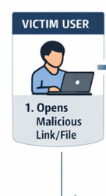
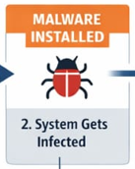
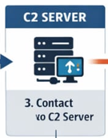
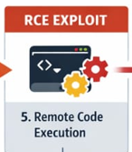
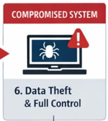
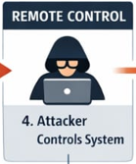
C2 & RCE ATTACK CHAIN
Connect to C2 Server
Execute Exploit
Steal data, install malware etc
Command & Control
Remote Code Execution

Slide 6
Simulation Section

Slide 7
Simulation Architecture
Dashboard
Detection Engine
Logging System
Encryption Layer
Client Agent
Server (Handler)

Slide 8
Project Structure
c2c_simulation/
│
├── dashboards/ # HTML session timeline outputs
│ ├── session_table.html # Generated table
│ │
├── detection_reports/ # Detection outputs
│ └── global_detection_report.json
│
├── rce_env/ # Virtual environment
│ └── ...
│
├── session_logs/ # JSON logs
│ └── all_sessions.json
│
├── rce_server.py # TCP server / handler
├── rce_client.py # TCP client / agent
├── dashboard.py # main dashboard generator
├── detection_engine.py # detection rules engine
├── session_logger.py # logging logic
├── run_simulation.py # main orchestrator
├── server_cert.pem # TLS certificate
└── server_key.pem # TLS private key

Slide 9
Detection Pipeline
Detection Engine parses logs
Displayed on dashboard
Activity is carried out
Logs generation
Indicators extracted

Slide 10
Detection Strategies
Network anomaly detection
Endpoint monitoring (EDR)
Correlation across sessions
Behavioral analytics
Command-line auditing
Notes:
Situation 1: Managing a Team Decision What happens: You present a plan in a meeting → everyone agrees → execution is weak or delayed
What’s really happening:
Respect → no one openly disagrees
Ambition → people may not fully buy in
Hidden concerns remain unspoken
Risk:
False alignment → poor execution Misreading the culture leads to silent resistance, not open failure
What to do:
Follow up informally
Ask indirect questions
Involve key influencers before final decisions
Situation 2: Negotiating with a Local Partner
What happens: You push for a quick, efficient deal → partner becomes slow or disengaged
What’s really happening:
Relationship not yet established
Pressure is perceived as disrespect or distrust
Risk:
Deal stalls or fails despite good terms
What to do:
Invest time in relationship first
Allow negotiation to evolve gradually
Show patience and respect
Failure is rarely loud — it is quiet, gradual, and relational

Slide 11
Mitigation Strategies
Patch vulnerable services
Security Awareness
Principle of least privilege
Network segmentation
Notes:
Situation 1: Managing a Team Decision What happens: You present a plan in a meeting → everyone agrees → execution is weak or delayed
What’s really happening:
Respect → no one openly disagrees
Ambition → people may not fully buy in
Hidden concerns remain unspoken
Risk:
False alignment → poor execution Misreading the culture leads to silent resistance, not open failure
What to do:
Follow up informally
Ask indirect questions
Involve key influencers before final decisions
Situation 2: Negotiating with a Local Partner
What happens: You push for a quick, efficient deal → partner becomes slow or disengaged
What’s really happening:
Relationship not yet established
Pressure is perceived as disrespect or distrust
Risk:
Deal stalls or fails despite good terms
What to do:
Invest time in relationship first
Allow negotiation to evolve gradually
Show patience and respect
Failure is rarely loud — it is quiet, gradual, and relational

Slide 12
Achievement
C2 communication
C2 communication
Detection dashboard
Logging system
RCE execution
Notes:
In the southeastern - Igbo professional context, who you are, who you know, and how you show respect often matters as much as what you do.
People may respect your title — but they follow your character, your fairness, and your ability to understand them.
In this environment, influence does not come from formal authority alone, but from your ability to build trust, navigate relationships, and manage ambition.
If you get the culture right, execution becomes easy. If you get it wrong, even the best strategy will fail quietly.

Slide 13
DEMO

Slide 14
THANK YOU

